Slide 1
Introduction to
Code Review

Slide 2
Agenda
Why Code Review
Code Review Guideline
  三層架構
  實做
  程式風格
  Commit massage naming
Code Review 專案實例 – Amazon
  Code review system
  Review example
Code Review專案實例 – Stryper
  Review example

Slide 3
Why Code Review
Performance improvements
  藉由審查找出不必要或重複性的程式碼，減少資源浪費
Find bugs in advance
  事前找出bug來降低開發成本
Accessibility
    維持一貫的程式風格來增加往後開發者的可讀性
Teaching and sharing knowledge between developers
  reviewer與author可以從中學習&分享經驗
Consistent coding architecture
  保持相同的程式架構可以增加可移植性
  針對不同的vendor code base Foxconn自訂義三層架構來保持程式架構的一致性

Slide 4
三層架構
分拆核心/硬體平台/功能集，目的在於讓功能集能夠搭配不同的硬體平台
  三層架構可以分成Vendor_API / FXN_API / FXN_feature三層架構，把API與feature layer獨立切開，轉換平台只需要改寫中間層FXN_API，省去開發FXN_feature時間
  以往架構是Vendor_API/FXN_APP(包含API與feature)，轉換硬體平台需改寫FXN_APP，需要一併修改API和feature
盡可能重複利用現有的程式碼與套件
  範例：執行序的管理
  範例：Timer的管理

Slide 5
實做(1/4)
Wrokaround 應加上註解說明理由
不得出現任何編譯器警告
任何執行時期的資源要求，必須有相對應的歸還動作
  範例：calloc/malloc必須有對應的free
  範例：pthread_create必須有對應的pthread_join/pthread_detach
  範例：open必須有對應的close
檔頭(Headers)
  檔頭裡的函數必須確實是界面的一部分
  檔頭裡的變數只能是extern
  檔頭如果使用不在C標準裡的類別，應主動引入(include)相關檔頭

Slide 6
實做(2/4)
如果修改了Kconfig，必須重新產生所有的configs
  - 只須make menuconfig，不做任何修改，存檔、離開
類別名稱
  一個類別只可有一個名字
    請避免這樣的雙重命名：typedef struct Name1 { … } Name2;
  盡可能使用 standard C library 定義的類別
    stdint.h
    - uint8_t / int8_t
    - uint16_t / int16_t
    - uint32_t / int32_t

Slide 7
實做(3/4)
巨集
  以 do...while(0) 包著整個巨集
    使用時機
      巨集裡使用 if / for / while 時
      巨集裡有多個敘述時

Slide 8
實做(4/4)
Log
  訊息必須令讀者容易了解
    難以理解的訊息：
    IRQ status changes from 1 to 2
    容易理解的訊息：
    GPIO IRQ subsystem is ready, no more registration is
    possible from now

Slide 9
程式風格(1/4)
請勿於檔頭填寫檔案資訊，像是做作者、撰寫日期等等的。這些資訊可以從Git取得，我們不必多花額外的人力去維護它。
切勿包含 #if 0
標頭檔開頭的守護者，使用「檔名全大寫，句點代之以底線」
  範例：檔名foxconn.h的守護者
    #ifndef FOXCONN_H
    #define FOXCONN_H
    #endif

Slide 10
程式風格(2/4)
函數名不應使用縮寫
  範例：一個處理電源鈕事件的Callback函數
    不適合的名字：RstPwrBtnISR
    適合的名字：OnResetPowerBotton
函數名不應使用縮寫
  範例：一個處理電源鈕事件的Callback函數
    不適合的名字：RstPwrBtnISR
    適合的名字：OnResetPowerBotton

Slide 11
程式風格(3/4)
全域變數命名
  跨越源檔的全域變數
    必須前綴g
    字首大寫
    範例：gCrossFileGlobalVariable
  單檔範圍的全域變數
    字首大寫
    範例：SingleFileGlobalVariable
Makefile裡的變數須以alphabetically排序
使用Linux風格的換行字元

Slide 12
程式風格(4/4)
libfoxconn 命名前綴
  定義型態或常數
    必須前綴FXN
    後接”_”及類別，再以”_”區隔
    範例： #define FXN_GPIO_HIGH 1
  libfoxconn 內部使用到的函數
    必須前綴Fxn
    後接類別，首字大寫
    範例： int FxnPowerControl(int actionID);
  銜接 AMI 的進入點函數
    必須前綴Fxn
    後接類別，首字大寫，以”_”區隔
    範例： void FxnGPIO_ConfigISR();
  銜接 AMI 的進入點函數
    必須前綴Fxn
    後接類別，首字大寫，以”_”區隔
    範例： void FxnGPIO_ConfigISR();

Slide 13
Commit Message naming(1/3)
一個Commit指實做一個功能、或是只修正一個問題
首行格式：範圍:類別: 簡短敘述
範圍
  Core
  P(平台名)
  F(功能集)

Slide 14
Commit Message naming(2/3)
類別
  feat - 新功能
  fix - 修正
  refactor - 重構程式碼
  chore - 不影響最後產出的映像檔功能的改動，例如
    編譯系統的程式碼
    組態系統的程式碼
    版號

Slide 15
Commit Message naming(3/3)
  docs - 任何針對文件的改動（程式碼註解不屬此類別）
  style - 改變或改善源碼風格，例如
    以空白取代Tab作為排版手段
    刪除不必要的行尾空白或是空白行
簡短敘述
  除非是專有名詞，其他請全數使用小寫。
  如果有QIS編號，貼上該編號，並以QIS標題作為敘述
  若為fix類別，敘述錯誤的行為
    例如：Core:fix: array subscript out of bound

Slide 16
Code Review 專案實例 – Amazon
Foxconn對於三層架構自訂義一套新的開發workflow
針對一個完成的Feature進行code review，不再是單一IPMI command
組成Code review system三必要系統
  Git server
  Build system
  Reboard board

Slide 17
Code Review – Amazon
Workflow
Feedback
構想與設計
文件化所設計的API
Design Review
Accept
提交實作
Code Review
驗證功能
開發實作
Accept
Feedback

Slide 18
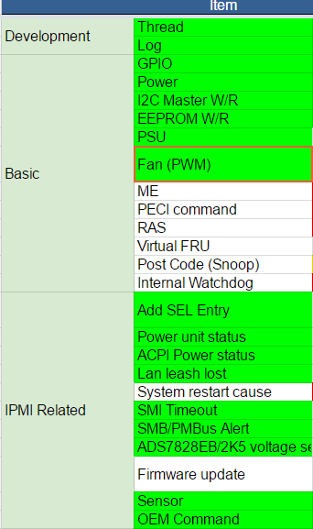
Feature
依據不同的feature做code review
把code提交到review board做code
review
每個人都可以參與code review
依照Code Review Guideline規則
進行code review

Slide 19
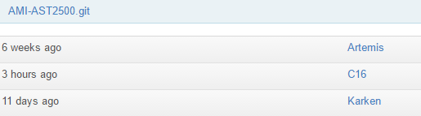
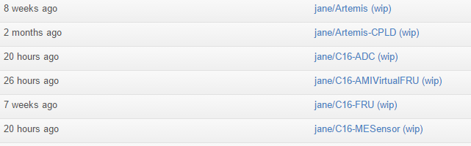
Git Server
以AMI-AST2500 code base為例
一個WIP為單一feature實作
完成後整合進C16當中

Slide 20
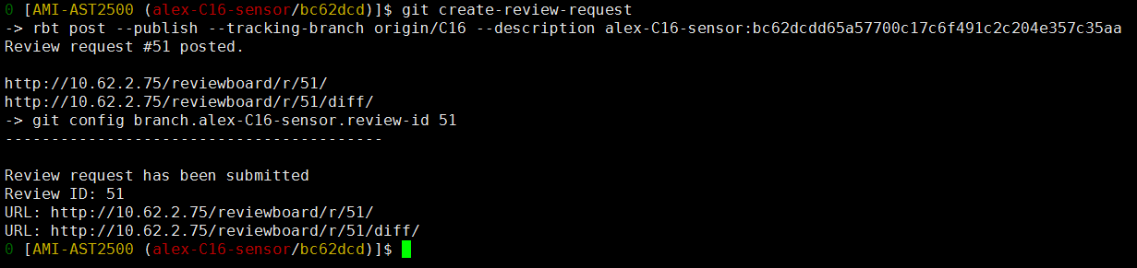
Build system
Commit implementation to review board
  在build system開發完成後，下review需求的指令build system會自動將我們開發的code提交到review board給大家review
  Build system會自動帶出review request的URL

Slide 21
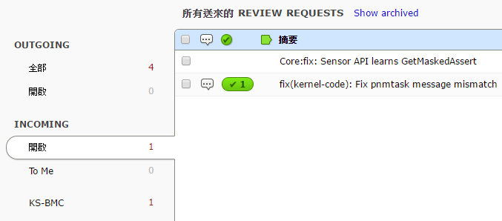
Review board system
http://10.62.2.75/reviewboard/dashboard/
可以查看已經提交的review request

Slide 22
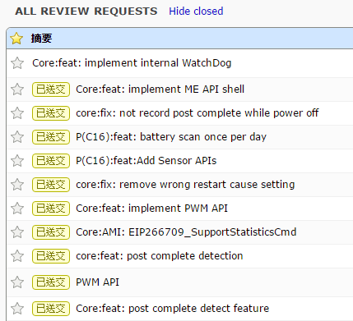
Review board system
所有已經review過的review request

Slide 23
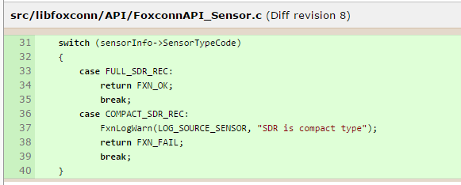
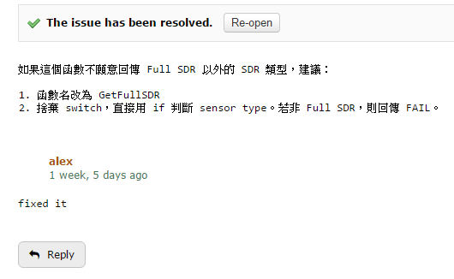
Code Review Format
Show diff code
Reviewer feedback
Author reply
Diff code
Feedback
Diff code

Slide 24
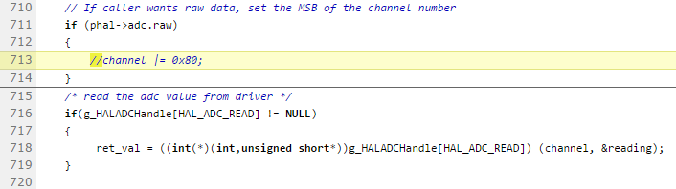
Example 1: ADC sensor reading
remove
Feedback
Please remove the whole code block.
  留下一個空內容的 if block 會對閱讀程式碼造成額外的負擔。
  根據 code review guideline，我們不希望留下 commented-out 的源碼。
Reply
Fixed it.

Slide 25
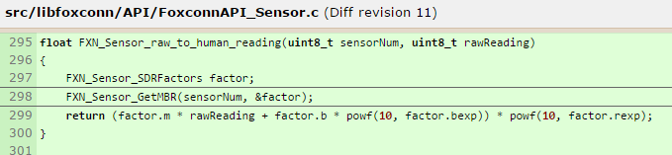
Example 2 : Sensor API
增加判斷與錯誤訊息
Feedback
  為了方便使用，轉換函數的回傳值一般不會用來表示成功或失敗。但考慮到 GetMBR 可能會失敗，這裡應該要產生一筆 Warning。
  之所以是 Warning 而非 Error，乃是因為轉換函數總是會成功。但若無法取得有效的 MBR，函數回傳的值很高機會是錯誤的。
Reply
Fixed it.

Slide 26
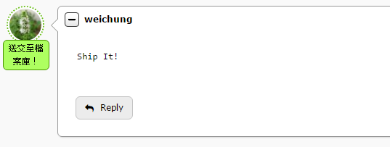
Ship code
Code review完成後提交到 Git 檔案庫
此功能的開發即完成

Slide 27
Code Review專案實例 – Stryper
針對已經上傳git 檔案庫的code進行code review
根據Get Healthy Plan對每個已經完成的細項功能進行code review
對每個細項撰寫一份code review report
  Reviewed functions
  Error handling

Slide 28
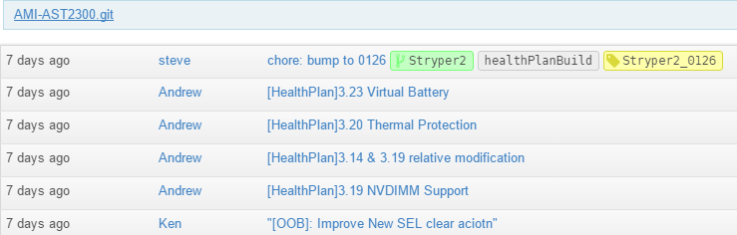
Stryper git 檔案庫
額外提交commit來修正code review文件的recommand

Slide 29
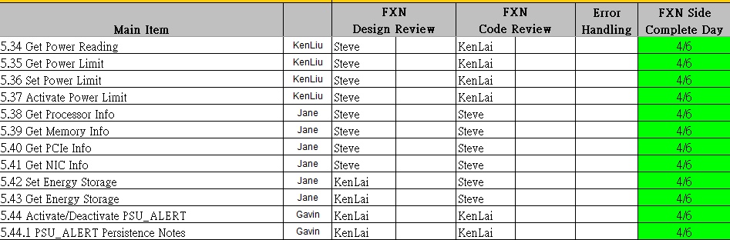
Get Healthy Plan (1/2)
在Get Healthy Plan根據每個細項功能做code review

Slide 30
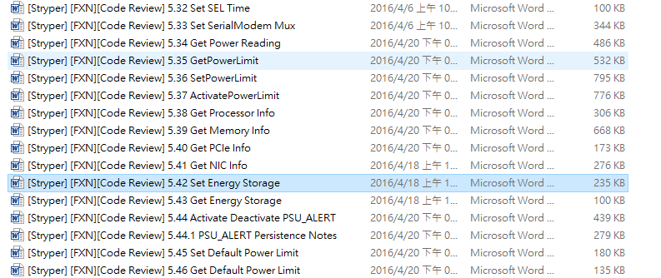
Get Healthy Plan(2/2)
每個code review 項目存成一個word檔

Slide 31
Code Review – Stryper
Code review document guideline
  Review items
  Review functions
  Error handling review functions

Slide 32
Example 1: 5.38 Get Processor Info
Review Items
FUNCTION/FEATURE | checked | Remark
F-1. Check all variables initialized before using. | Y
F-2. Check there are no unused variables. | Y
F-3. Check the codes match the specification function feature. | Y
F-4. Check the code can be modified simpler. | Y
F-5. Check code used appropriate, include algorithms, data structures, types, templates, libraries, RTOS functions | Y
ERROR HANDLING
E-1. Check the input parameters have correct type. | Y
E-2. Check the error return codes had been handle properly. | Y
E-3. Check the negative numbers handled properly. | Y
E-4. Check the pointers usage properly. | Y
E-5. Check the condition (if/switch) statements have a default clause used for error detection. | Y
E-6. Check index of the arrays to not occur out of range value. | Y
E-7. Check the memory leak (memory free properly). | Y
E-8. Check the overflow/underflow for mathematical. | Y
＊-->If there is a ‘＊’in remark box, it indicates that there is an error which needs to be fixed.

Slide 33
Review function
List all reviewed functions and file path
  WCSGetPersistentProcessorINFOEEPROM(src/libraries/libipmiwcs-1.0.0/WCSCore.c)
  WCSSetProcessorInfo(src/libraries/libipmiwcs-1.0.0/WCSCmds.c)
  WCSGetProcessorInfo(src/libraries/libipmiwcs-1.0.0/WCSCmds.c)
Content Format
  Comment (Suggestion)
  Error (MUST Fixed)

Slide 34
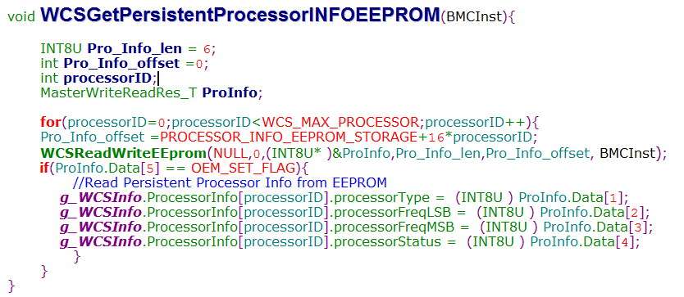
Review function - WCSGetPersistentProcessorINFOEEPROM
The functions is reviewed BMCInst and default EEPROM value is the detailed review result for each comments:
改成
int BMCInst
寫入
Default EEPROM
  comment(Suggestion):
  Recommend to replace “BMCInst” with “int BMCInst”. This declaration way can’t affect compiler execution currently.
  Recommend processor info need to write default value to EEPROM when “ProInfo.Data[5] != OEM_SET_FLAG”.
Error (MUST Fixed):
N/A

Slide 35
Error handling
List all reviewed functions and file path
  WCSGetPersistentProcessorINFOEEPROM(src/libraries/libipmiwcs-1.0.0/WCSCore.c)
Format
  Show error handling code
  Comment (Suggestion)
  Error (MUST Fixed)

Slide 36
Error handling - WCSSetProcessorInfo
if(processorID >= WCS_MAX_PROCESSOR){ BMC_CMD_PRINT("%s %d Input data out of range (0-1) ! \r\n",__FUNCTION__,__LINE__); pRes[0] = CC_PARAM_OUT_OF_RANGE; return (nLen); // Length of the bioscode including the completion code }
pData = (WCSWriteEEPROM_T*)malloc(sizeof(WCSWriteEEPROM_T)); if(!pData){ printf("%s %d malloc fail!!\n",__func__,__LINE__); } else{ pData->offset = PROCESSOR_INFO_EEPROM_STORAGE + 16*processorID; pData->length = 6; memcpy(pData->data, pReq, 5); pData->data[5] = OEM_SET_FLAG; OS_CREATE_THREAD(WriteEEPROMTask, (void*)pData, 0); }
  comment(Suggestion):
Work as design
Error (MUST Fixed):
N/A

Slide 37
Example 2: 5.39 Get Memory Info
Review Items
FUNCTION/FEATURE | checked | Remark
F-1. Check all variables initialized before using. | Y
F-2. Check there are no unused variables. | Y
F-3. Check the codes match the specification function feature. | Y
F-4. Check the code can be modified simpler. | Y
F-5. Check code used appropriate, include algorithms, data structures, types, templates, libraries, RTOS functions | Y
ERROR HANDLING
E-1. Check the input parameters have correct type. | Y
E-2. Check the error return codes had been handle properly. | Y
E-3. Check the negative numbers handled properly. | Y
E-4. Check the pointers usage properly. | Y
E-5. Check the condition (if/switch) statements have a default clause used for error detection. | Y
E-6. Check index of the arrays to not occur out of range value. | Y
E-7. Check the memory leak (memory free properly). | Y
E-8. Check the overflow/underflow for mathematical. | Y
＊-->If there is a ‘＊’in remark box, it indicates that there is an error which needs to be fixed.

Slide 38
Review function
List all reviewed functions and file path
  SetDefaultMemmoryThread(src/libraries/libipmiwcs-1.0.0/WCSCore.c)
  WCSSetMemoryInfo(src/libraries/libipmiwcs-1.0.0/WCSCmds.c)
  NVDIMMInit(src/libraries/libipmiwcs-1.0.0/WCSCore.c)
Content Format
  Comment (Suggestion)
  Error (MUST Fixed)

Slide 39
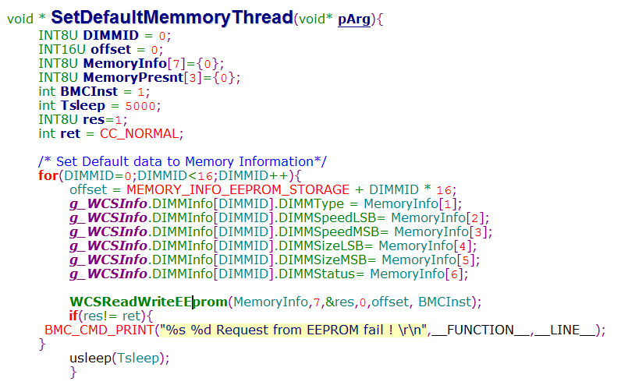
Review function – SetDefaultMemmoryThread(1/2)
The functions is reviewed WCS_MAX_DIMM_SLOT , OEM_SET_FLAG and NOT_PRESENT are the detailed review result for each comments:
改成 WCS_MAX_DIMM_SLOT
DIMM TYPE = 0X3F
DIMM STATUS = 0X3
Comment(Suggestion):
  Recommend to replace 16 with macro defined WCS_MAX_DIMM_SLOT.
  We initialize DIMM type and status as 0x3f and 0x3 in WCSInit(). Recommend to write DIMM type and status to EEPROM as 0x3f and 0x3 instead of 0 when MemPresent.Data[3] != OEM_SET_FLAG.

Slide 40
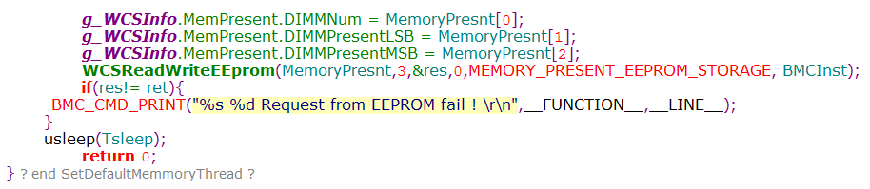
Review function – SetDefaultMemmoryThread(2/2)
改成 NOT_PRESENT
  Comment(Suggestion):
  Recommend to replace 0x3 with macro defined NOT_PRESENT like WCS Spec. In WCSInit function
Error (MUST Fixed):
N/A

Slide 41
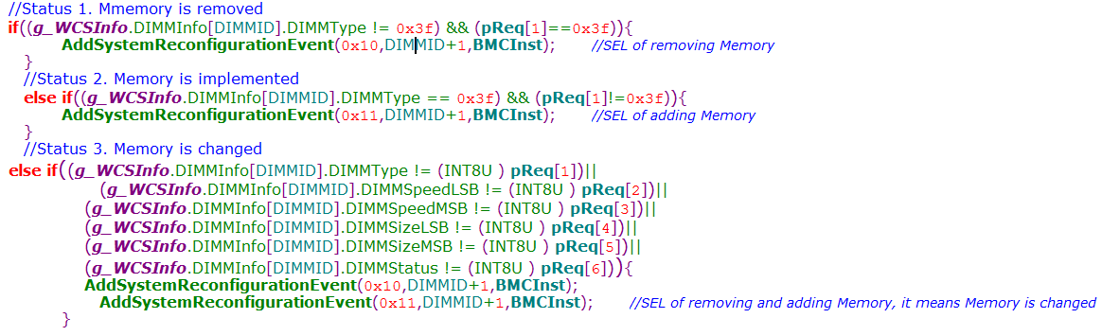
Review function - WCSSetMemoryInfo
The functions is reviewed NOT_PRESENT is the detailed review result for each comments:
改成 NOT_PRESENT;
  Comment(Suggestion):
  Recommend to replace 0x3f with macro defined NOT_PRESENT like WCS Spec. In WCSInit function
Error (MUST Fixed):
N/A

Slide 42
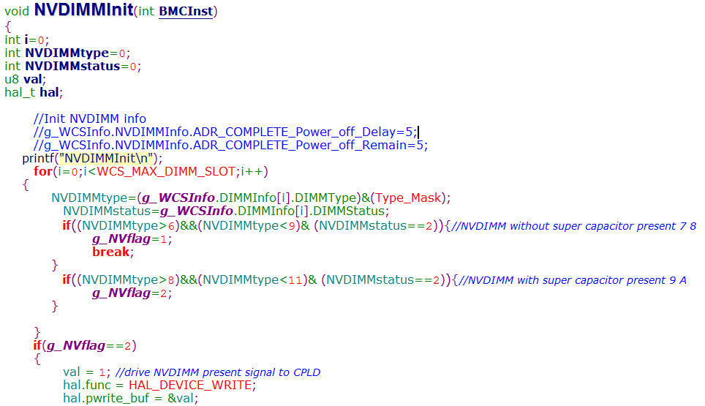
Review function - NVDIMMInit
The functions is reviewed parameter g_Nvflag is the detailed review result for each comments:
少加了 break;
  comment(Suggestion):
  Recommend to add “break;” after “g_NVflag=2;”. Styper2 MB just inserts one kind of NVDIMM in the same time, so it doesn’t affect test result.
Error (MUST Fixed):
N/A

Slide 43
Error handling
List all reviewed functions and file path
  SetDefaultMemmoryThread(src/libraries/libipmiwcs-1.0.0/WCSCore.c)
  WCSSetMemoryInfo(src/libraries/libipmiwcs-1.0.0/WCSCmds.c)
Format
  Show error handling code
  Comment (Suggestion)
  Error (MUST Fixed)

Slide 44
Error handling - SetDefaultMemmoryThread
WCSReadWriteEEprom(MemoryInfo,7,&res,0,offset, BMCInst); if(res!= ret){ BMC_CMD_PRINT("%s %d Request from EEPROM fail ! \r\n",__FUNCTION__,__LINE__); }
WCSReadWriteEEprom(MemoryPresnt,3,&res,0,MEMORY_PRESENT_EEPROM_STORAGE, BMCInst); if(res!= ret){ BMC_CMD_PRINT("%s %d Request from EEPROM fail ! \r\n",__FUNCTION__,__LINE__); }
  comment(Suggestion):
Work as design
Error (MUST Fixed):
N/A

Slide 45
Error handling - WCSSetMemoryInfo
if((DIMMID> WCS_MAX_DIMM_SLOT)||(!DIMMID)){ BMC_CMD_PRINT("%s %d Input data out of range (1-16) ! \r\n",__FUNCTION__,__LINE__); pRes[0] = CC_PARAM_OUT_OF_RANGE; return (nLen); // Length of the bioscode including the completion code }
pData = (WCSWriteEEPROM_T*)malloc(sizeof(WCSWriteEEPROM_T)); if(!pData){ printf("%s %d malloc fail!!\n",__func__,__LINE__); }
pData2 = (WCSWriteEEPROM_T*)malloc(sizeof(WCSWriteEEPROM_T)); if(!pData2){ printf("%s %d malloc fail!!\n",__func__,__LINE__); }
  comment(Suggestion):
Work as design
Error (MUST Fixed):
N/A

Slide 46
Example 3: 5.40 Get PCIe Info
Review Items
FUNCTION/FEATURE | checked | Remark
F-1. Check all variables initialized before using. | Y
F-2. Check there are no unused variables. | Y
F-3. Check the codes match the specification function feature. | Y
F-4. Check the code can be modified simpler. | Y
F-5. Check code used appropriate, include algorithms, data structures, types, templates, libraries, RTOS functions | Y
ERROR HANDLING
E-1. Check the input parameters have correct type. | Y
E-2. Check the error return codes had been handle properly. | Y
E-3. Check the negative numbers handled properly. | Y
E-4. Check the pointers usage properly. | Y
E-5. Check the condition (if/switch) statements have a default clause used for error detection. | Y
E-6. Check index of the arrays to not occur out of range value. | Y
E-7. Check the memory leak (memory free properly). | Y
E-8. Check the overflow/underflow for mathematical. | Y
＊-->If there is a ‘＊’in remark box, it indicates that there is an error which needs to be fixed.

Slide 47
Review function
List all reviewed functions and file path
  WCSGetPCIeInfo (src/libraries/libipmiwcs-1.0.0/WCSCmds.c)
  WCSSetPCIeInfo(src/libraries/libipmiwcs-1.0.0/WCSCmds.c)
Content Format
  Comment (Suggestion)
  Error (MUST Fixed)

Slide 48
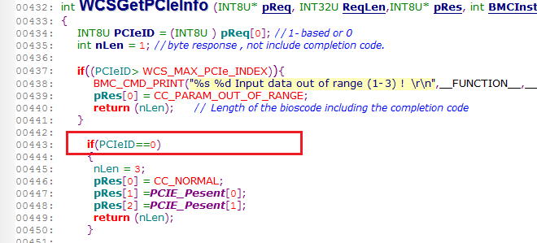
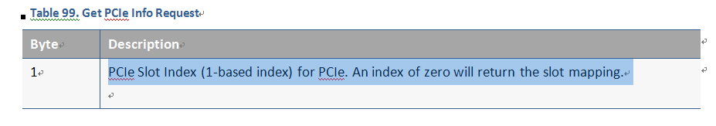
Review function - WCSGetPCIeInfo
The functions is reviewed parameter NOT_PRESENT is the detailed review result for each comments:
改成 NOT_PRESENT
  comment(Suggestion):
  Acccording the Table99, we can use marco “NOT_PRESENT” to instead the “PCIeID==0” as define.

Slide 49
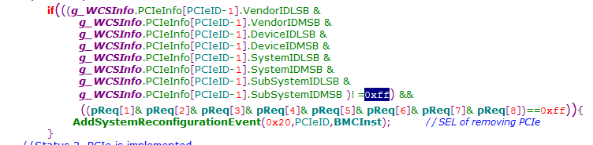
Review function - WCSSetPCIeInfo
The functions is reviewed parameter PCIeID is the detailed review result for each comments:
改成 NOT_PRESENT
  comment(Suggestion):
  Status change from NOT installed to install. The “0xff” can using macro “ NOT_PRESENT” to instead
Error (MUST Fixed):
N/A

Slide 50
Error handling
List all reviewed functions and file path
  WCSGetPCIeInfo (src/libraries/libipmiwcs-1.0.0/WCSCmds.c)
  WCSSetPCIeInfo(src/libraries/libipmiwcs-1.0.0/WCSCmds.c)
Format
  Show error handling code
  Comment (Suggestion)
  Error (MUST Fixed)

Slide 51
Error handling - WCSGetPCIeInfo
if((PCIeID> WCS_MAX_PCIe_INDEX)){ BMC_CMD_PRINT("%s %d Input data out of range (1-3) ! \r\n",__FUNCTION__,__LINE__); pRes[0] = CC_PARAM_OUT_OF_RANGE; return (nLen); // Length of the bioscode including the completion code }
if(PCIeID==0) { nLen = 3; pRes[0] = CC_NORMAL; pRes[1] =PCIE_Pesent[0]; pRes[2] =PCIE_Pesent[1]; return (nLen); }
  comment(Suggestion):
  This function support error handling when “PCIeID” out of range
  This function support error handling when “PCIeID==0”, do special case
Error (MUST Fixed):
N/A

Slide 52
Error handling - WCSSetPCIeInfo
if((PCIeID == 0 && ReqLen != 3) || (PCIeID != 0 && ReqLen != 9)){ pRes[0] = CC_REQ_INV_LEN; return (nLen); } if(PCIeID> WCS_MAX_PCIe_INDEX){ BMC_CMD_PRINT("%s %d Input data out of range (1-13) ! \r\n",__FUNCTION__,__LINE__); pRes[0] = CC_PARAM_OUT_OF_RANGE; return (n
  comment(Suggestion):
  This function support error handling when “(PCIeID == 0 && ReqLen != 3) || (PCIeID != 0 && ReqLen != 9)”
  This function support error handling when “PCIeID> WCS_MAX_PCIe_INDEX”
Error (MUST Fixed):
N/A

